Slide 1

Drone Delivery Path Planner
D A A H A C K A T H O N P R O J E C T
Smarter Routes. Better Priorities. Efficient Battery Usage.
Route optimization with Dijkstra, TSP and Priority Queue under distance, battery and priority constraints.
T E A M
J. Ravi Kumar · M. Saketh · G. Tharak · L. Gowtham
Domain: Route Planning · Design & Analysis of Algorithms

Slide 2







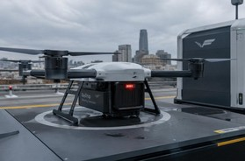
The Challenge
02
E X A M P L E
100 available
125 required
Route Rejected — Battery Budget Exceeded
Limited battery capacity
Different delivery priorities
Multiple destinations
Varying travel distances
Route optimization
Return to depot when required
A route that is too long may exceed the drone's battery budget and must be rejected.

Slide 3



Our Innovation
03
Explainable output
•
Why the route was selected
Total distance Battery consumption Delivery order Constraints satisfied?
Why a route was rejected
Priority Queue
Selects deliveries by priority: High → Medium → Low
Dijkstra
Finds the shortest / least-cost path between locations
TSP
Finds an efficient sequence for visiting all stops
•
•
•
•
•
U N I Q U E A P P R O A C H
Priority + Shortest Path + Route Optimization + Battery Validation

Slide 4







How It Works
04
BATTERY CHECK
Validate constraints
INPUT
Drone, locations, priorities, graph
PRIORITY QUEUE
Select delivery order
DIJKSTRA
Shortest paths
TSP
Optimize stop sequence
O U T P U T
Optimized route
Delivery sequence
Total distance
Battery consumed
Remaining battery
Route status

Slide 5


Technology & Algorithms
05
Technology | Purpose
React | Frontend / UI
Python | Algorithm implementation
Flask | Backend / API
Leaflet | Interactive map
Priority Queue
Priority-based selection
O(log n)
Dijkstra (binary heap)
Shortest path
O((V+E) log V)
TSP (brute force)
Multi-stop sequencing
O(n!)
TSP becomes computationally expensive as delivery locations increase.

Slide 6

Demo & Results
06
High
Medium
Low
Depot → D1 → D3 → D2 → D4 → Depot
D3
4
Deliveries
2
High priority
D1
D2
[XX] km
Total distance
[XX] u
Battery used
Feasible · [XX] u left
D4
Depot
Sample / demo values — not measured results.

Slide 7





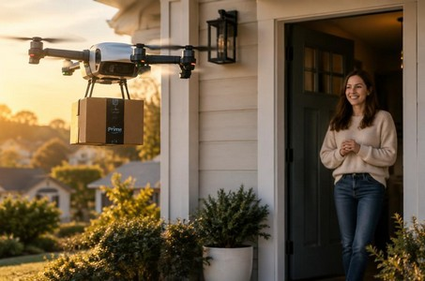
Impact & Practical Benefits
07
B E F O R E
Battery-Aware Rejects routes exceeding battery
Priority-Based Important deliveries first
Shortest Path Dijkstra cuts extra travel
A F T E R
Optimized Order TSP sequences multi-stop trips
Explainable
See why routes pass or fail
Interactive Map Routes visualized on Leaflet
More systematic route planning with clear constraint validation.

Slide 8
Future Vision
08
Real-time tracking
Weather-aware routing
Dynamic requests
C U R R E N T P R O T O T Y P E
Priority Queue + Dijkstra
+ TSP + Battery Validation
Multi-drone optimization
Live battery monitoring
Airspace restrictions
ML demand prediction
Large-scale optimization
Real drone integration
“Smarter Routes. Better Priorities. Safer Battery Usage.”
Thank You · Questions?
J. Ravi Kumar | M. Saketh | G. Tharak | L. Gowtham

